Slide 1

Covariance and Correlation of Multiple Signals Data X: A Course on Data, Signals, and Systems
Data ^{X}
About Me:
Ikhlaq Sidhu Chief Scientist & Founding Director, Sutardja Center for Entrepreneurship & Technology IEOR Emerging Area Professor Award, UC Berkeley

Slide 2
Multiple Signals:

Slide 3
Correlation and Covariance

Slide 4
Correlation and Covariance
Properties

Slide 5
Covariance: Alternative Format

Slide 6
Correlation Matrix
Table
Window W
x1 x2 … xn
Samples
1
2
3
4
5
6
W
.
.
.
x1
Samples from Window of W
x2
xn
Many samples, or a sequence in time
x1(t), x2(t), .. xn(t)
To estimate from data:
Use all samples ever collected
Use window size of W samples of each to estimate a recent Corr Matrix

Slide 7
Correlation Matrix
Corr(x1,x1) = 1
Corr(x2, x1)
= E[ XY – E[X]E[y] ] / stdev(x) stdev(y)
You could even do this by hand:
Corr(x1,x1) ……..
Corr(x1,xn)
Corr(xn,x1)
x1 x2 E[x1 x2] E[x1] E[x2]
1 2 2 1.5 2.5 2 4 1 1 2 3
Corr(xn,xn)
To estimate from data:
Use all samples ever collected
Use window size of W samples of each to estimate recent Corr Matrix

Slide 8
Code Examples: Correlation of Rows with NumPy
Import numpy as np
x = [[0.1, .32, .2, 0.4, 0.8],
[.23, .18, .56, .61, .12],
[.9, .3, .6, .5, .3],
[.34, .75, .91, .19, .21]]
np.corrcoef(x)
Out[4]: array([
[ 1. , -0.35153114, -0.74736506, -0.48917666],
[-0.35153114, 1. , 0.23810227, 0.15958285],
[-0.74736506, 0.23810227, 1. , -0.03960706],
[-0.48917666, 0.15958285, -0.03960706, 1. ]
])
Here each row is a vector of length 5
There are 4 vectors
Correlation matrix is 4 x
If you want the correlation of the columns,
just use
np.corrcoef ( np.transpose(x) )
For a window, use a slice:
window = x[0:4,3:5] for the last
two columns

Slide 9
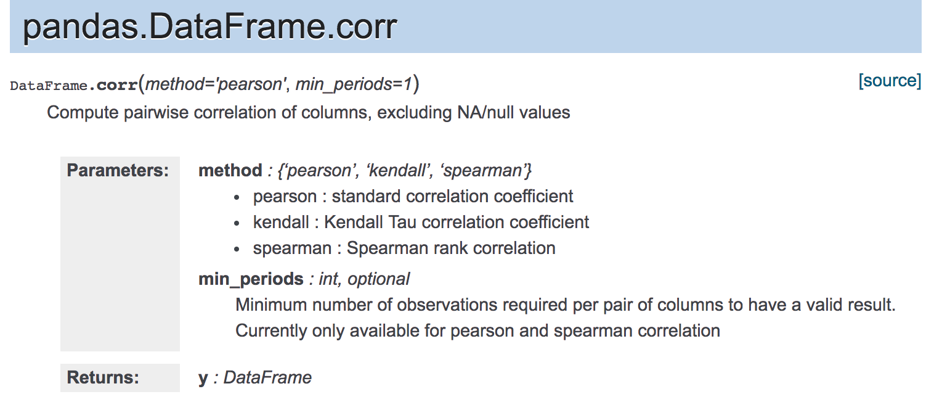
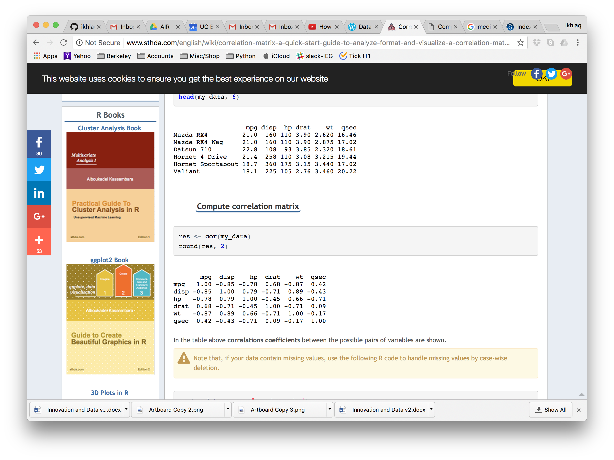
Correlation of Features from Different Sources
Pandas Table
Use corr()

Slide 10
Pandas will create a correlation matrix with “columns”

Slide 11
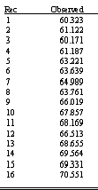
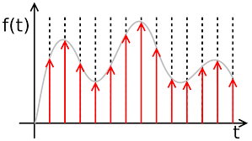
Approaches to the Data Sequences in Tables
Predictions or classifications on
A, B, C
Discrete data for each source A, B, C..
x_{n} = x1, x2, x3, …
Each row is a source: A, B, C..
Columns are features
u st.
A: f1, f2, f3, …
B: f1, f2, f3, …
C: f1, f2, f3, …
D: f1, f2, f3, …
f1 f2 f3
f1 1 .3 -.2
f2 -2 1 .4
f3 0 -.6 1
One row for each source
A, B, C, D..
Eg Numpy arrays
A: x1, x2, x3, …
B: x1, x2, x3, …
C: x1, x2, x3, …
D: x1, x2, x3, …
Correlation of features over all sources
Filters,
functions,
convolution..
Each row is a time
columns are features
Predictions or classifications on
Time 1, 2, 3 ..
A
x1
x2
x3
.
.
B
x1
x2
x3
.
.
C
x1
x2
x3
.
.
One column
for each series:
A , B, C, D..
eg Pandas
(add rows with every new time sample)
1
2
3
.
.
1: f1, f2, f3, …
2: f1, f2, f3, …
3: f1, f2, f3, …
4: f1, f2, f3, …
Correlation of sources
over a time period
A B C
A 1 .3 -.2
B -2 1 .4
C 0 -.6 1

Slide 12
Properties of Correlation

Slide 13
Properties of Correlation

Slide 14
Properties of Correlation

Slide 15
More Conversions from Real Time Data
Single Signals (an array)
Fourier Tansform: DTFT and FFT -> features that have spectral information
Pattern Matching -> feature = does the pattern exist, or how strongly
More types of scoring: mapping a vector to a single number
Multiple Inputs (multiple arrays or a matrix)
Cross correlation matrix
Jacobian Matrix – What is causing the most change?

Slide 17
End of Section

Slide 18
Code Examples: Correlation

Slide 19
Properties of Correlation

Slide 20
Properties of Correlation

Slide 21
End of Section

Slide 22
Properties of Correlation

Slide 23
More Conversions from Real Time Data
Single Signals (an array)
Fourier Tansform: DTFT and FFT -> features that have spectral information
Pattern Matching -> feature = does the pattern exist, or how strongly
More types of scoring: mapping a vector to a single number
Multiple Inputs (multiple arrays or a matrix)
Cross correlation matrix
Jacobian Matrix – What is causing the most change?

